Slide 1
Creational Design Patterns
Instructor: Muhammad Zeeshan Nazar

Slide 2
Creational Design Patterns
Creational design patterns provide various object creation mechanisms, which increase flexibility and reuse of existing code.
Creational design patterns abstract the instantiation process.
They help make a system independent of how its objects are created, composed, and represented.
A class creational pattern uses inheritance to vary the class that's instantiated.
An object creational pattern will delegate instantiation to another object.

Slide 3
Creational Design Patterns
First, they all encapsulate knowledge about which concrete classes the system uses.
Second, they hide how instances of these classes are created and put together.
Creational patterns give you a lot of flexibility in what gets created, who creates it, how it gets created, and when.

Slide 4
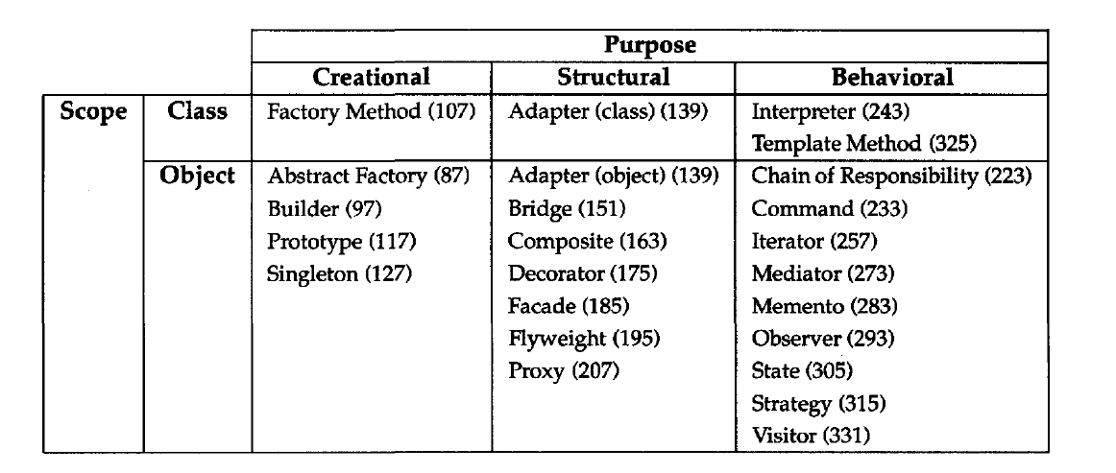
Catalog of Design Patterns

Slide 5
Singleton Pattern

Slide 6

Singleton Pattern
Intent
Singleton is a creational design pattern that lets you ensure that a class has only one instance, while providing a global access point to this instance.

Slide 7
Problem
The Singleton pattern solves two problems at the same time:
Ensure that a class has just a single instance.
Why would anyone want to control how many instances a class has?
The most common reason for this is to control access to some shared resource—for example, a database or a file.
Imagine that you created an object, but after a while decided to create a new one. Instead of receiving a fresh object, you’ll get the one you already created.
This behavior is impossible to implement with a regular constructor since a constructor call must always return a new object by design.

Slide 8
Problem
Provide a global access point to that instance.
Just like a global variable, the Singleton pattern lets you access some object from anywhere in the program.
However, it also protects that instance from being overwritten by other code.
There’s another side to this problem:
You don’t want the code that solves problem #1 to be scattered all over your program. It’s much better to have it within one class, especially if the rest of your code already depends on it.

Slide 9
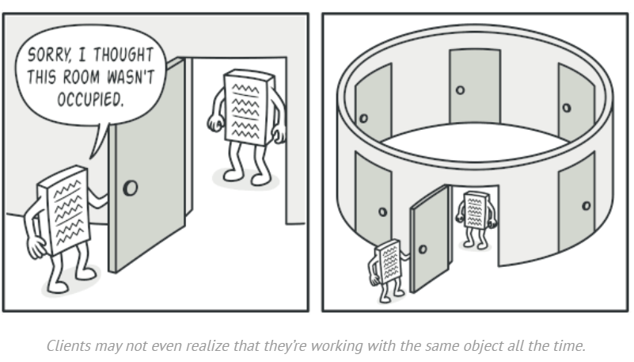

Slide 10
Solution
All implementations of the Singleton have these two steps in common:
Make the default constructor private, to prevent other objects from using the new operator with the Singleton class.
Create a static creation method that acts as a constructor. Under the hood, this method calls the private constructor to create an object and saves it in a static field. All following calls to this method return the cached object.
If your code has access to the Singleton class, then it’s able to call the Singleton’s static method. So, whenever that method is called, the same object is always returned.

Slide 11
Real World Analogy
The government is an excellent example of the Singleton pattern.
A country can have only one official government.
Regardless of the personal identities of the individuals who form governments, the title, “The Government of X”, is a global point of access that identifies the group of people in charge.

Slide 12
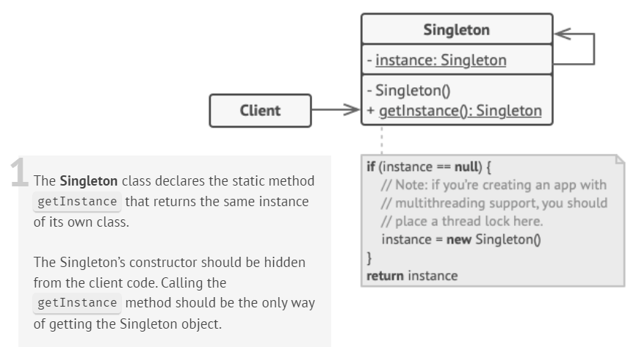
Strcuture

Slide 13
Implementation (Lazy Initialization)
class Singleton {
private:
static Singleton *instance;
int data;
// Private constructor so that no objects can be created.
Singleton() {
data = 0;
}
public:
// Lazy Initialization
static Singleton *getInstance() {
if (instance == NULL) {
instance = new Singleton();
}
return instance;
}
int getData() {
return this -> data;
}
void setData(int data) {
this -> data = data;
}
};

Slide 14
Implementation
//Initialize pointer with NULL so that it can be initialized in first call to getInstance()
Singleton *Singleton::instance = NULL;
int main(){
Singleton *s = Singleton::getInstance();
s->setData(7);
cout << s->getData() << endl;
Singleton *p = Singleton::getInstance();
p->setData(100);
cout << p->getData() << endl;
return 0;
}
Output:
// 7
// Address of s : 0x1793010
// 100
// Address of p : 0x1793010

Slide 15
Implementation (Eager Initialization)
#include <iostream>
using namespace std;
class Singleton {
private:
static Singleton* instance; // Static pointer to single instance
int data;
// Private constructor so no one can create new objects
Singleton() {
data = 0;
cout << "Singleton Instance Created!" << endl;
}
public:
// Global access point
static Singleton* getInstance() {
return instance;
}
int getData() { return data; }
void setData(int d) { data = d; }
};
// Create the instance eagerly (before program starts)
Singleton* Singleton::instance = new Singleton();
int main() {
// Even before calling getInstance(), the instance already exists.
Singleton* s1 = Singleton::getInstance();
s1->setData(42);
Singleton* s2 = Singleton::getInstance();
cout << "Data from s2: " << s2->getData() << endl;
return 0;
}
Output:
Singleton Instance Created!
Data from s2: 42
Notes:
If you have one singleton class, you can do eager initialization. If you have multiple singleton classes, you can do lazy initialization to save memory.

Slide 16
Implementation (Lazy Initialization in Multi-Thread)
#include <iostream>
#include <thread>
using namespace std;
class Singleton {
private:
static Singleton* instance;
Singleton() { cout << "Instance created\n"; }
public:
// Lazy Initialization with synchronization
static Singleton* getInstance() {
if (instance == NULL) { // Not thread-safe
instance = new Singleton();
}
return instance;
}
};
Singleton* Singleton::instance = NULL;
void threadFunc() {
Singleton* s = Singleton::getInstance();
}
int main() {
thread t1(threadFunc);
thread t2(threadFunc);
t1.join();
t2.join();
}
Output:
Instance created
Instance created <-- ❌ Two instances created! (NOT Singleton)

Slide 17
Implementation Method 1 (Lazy Initialization in Multi-Thread)
#include <iostream>
#include <mutex>
#include <thread>
using namespace std;
class Singleton {
private:
static Singleton* instance;
static mutex mtx;
Singleton() { cout << "Instance created\n"; }
public:
static Singleton* getInstance() {
lock_guard<mutex> lock(mtx); // Lock while checking
if (instance == NULL) {
instance = new Singleton();
}
return instance;
}
};
Singleton* Singleton::instance = NULL;
mutex Singleton::mtx;
void threadFunc() {
Singleton* s = Singleton::getInstance();
}
int main() {
thread t1(threadFunc);
thread t2(threadFunc);
t1.join();
t2.join();
}
Output:
Instance created // Object is created only one time.

Slide 18
Implementation Method 2 (Lazy Initialization in Multi-Thread)
#include <iostream>
#include <thread>
using namespace std;
class Singleton {
private:
// Private constructor to prevent creating objects manually
Singleton() {
cout << "Instance created" << endl;
}
public:
// Public global access point
static Singleton& getInstance() {
static Singleton instance; // Created only once, thread-safe in
return instance;
}
void showMessage() {
cout << "Hello from Singleton!" << endl;
}
};
void threadFunction() {
Singleton& s = Singleton::getInstance();
s.showMessage();
}
int main() {
thread t1(threadFunction);
thread t2(threadFunction);
thread t3(threadFunction);
t1.join();
t2.join();
t3.join();
return 0;
}
Output:
Instance created
Hello from Singleton!
Hello from Singleton!
Hello from Singleton!

Slide 19
Implementation (Globel Access Point)
#include <iostream>
using namespace std;
class Database {
private:
static Database* instance; // Holds the single instance
Database() { // Private constructor
cout << "Database Connected\n";
}
public:
// Global access point
static Database* getInstance() {
if (instance == NULL) {
instance = new Database();
}
return instance;
}
void query(string sql) {
cout << "Executing: " << sql << endl;
}
};
// Initialize the static member
Database* Database::instance = NULL;
int main() {
// Access the same instance globally
Database* db1 = Database::getInstance();
db1->query("SELECT * FROM Students");
Database* db2 = Database::getInstance();
db2->query("DELETE FROM Students WHERE id=1");
// Both pointers point to the same instance
cout << "Address of db1: " << db1 << endl;
cout << "Address of db2: " << db2 << endl;
return 0;
}
Database Connected
Executing: SELECT * FROM Students
Executing: DELETE FROM Students WHERE id=1
Address of db1: 0x123456
Address of db2: 0x123456

Slide 20
References
Design Patterns: Elements of Reusable Object-Oriented Software, Erich Gamma, Richard Helm, Ralph Johnson, and John Vlissides, Pearson, 1995.
Helping Links:
https://refactoring.guru/design-patterns/
https://www.geeksforgeeks.org/factory-method-for-designing-pattern/
https://sourcemaking.com/design_patterns/

